Slide 1
Parallel Programming in CUDA C
Instructor
Dr. B. Krishna Priya

Slide 2
Outline
CUDA parallel programming
Summing vectors
A fun example

Slide 3
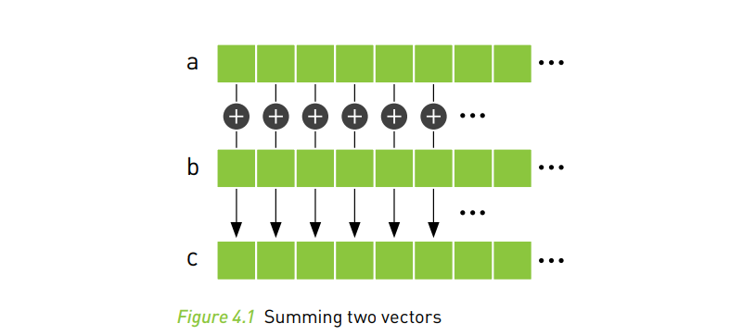
CUDA Parallel Programming
Summing Vectors:
Imagine having two lists of numbers where we want to sum corresponding elements of each list and store the result in a third list.

Slide 4
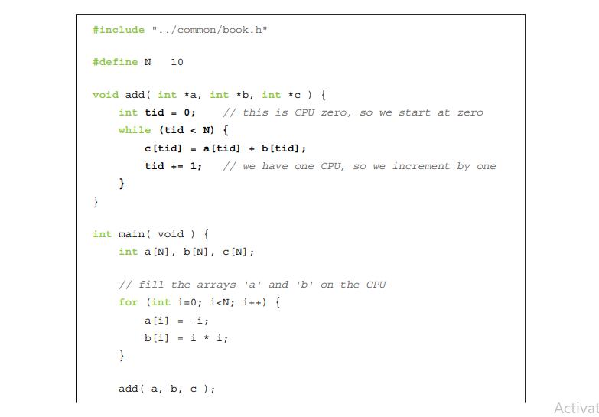

Slide 5
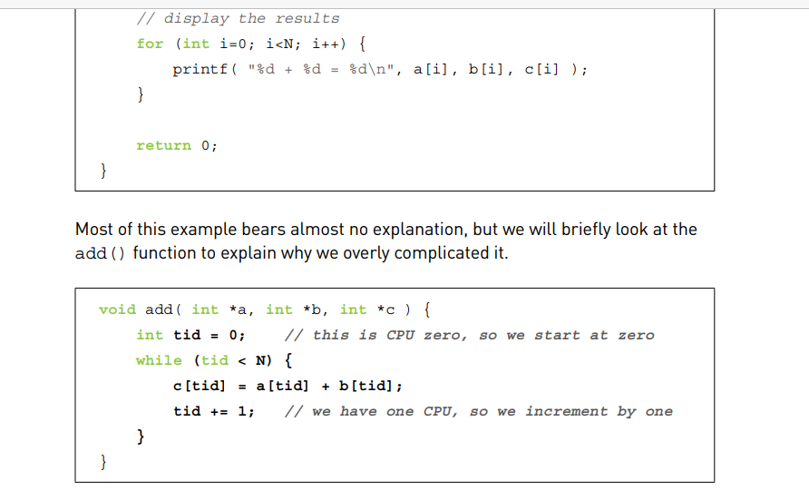

Slide 6
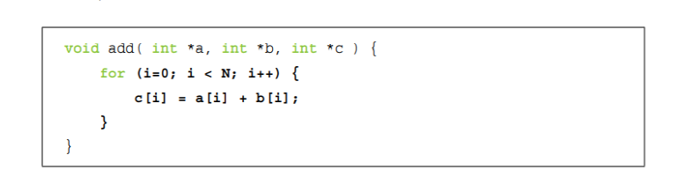

Slide 7
one core initialize the loop with tid = 0 and another with tid = 1. The first core would add the even-indexed elements, and the second core would add the odd indexed elements.

Slide 8
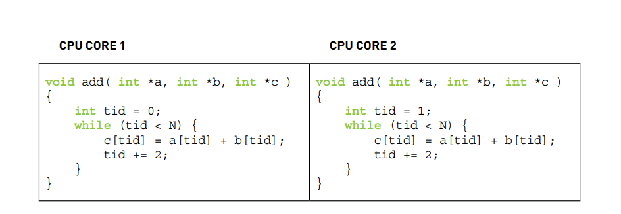

Slide 9
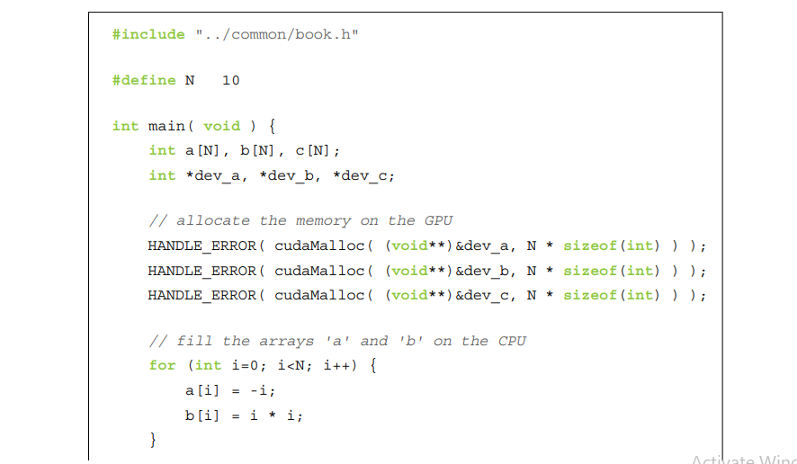
GPU vector sums

Slide 10
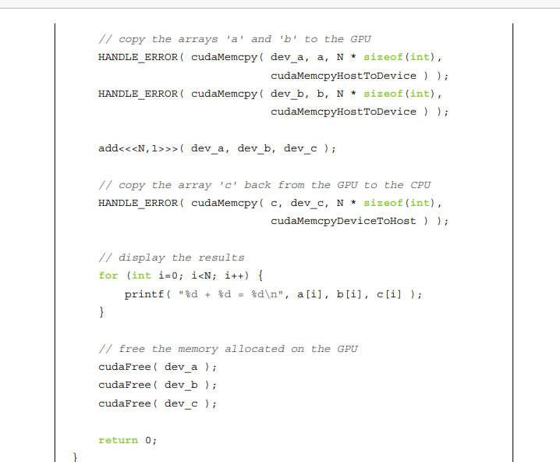

Slide 11
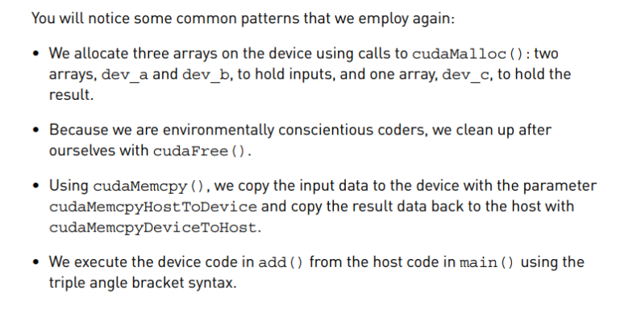

Slide 12
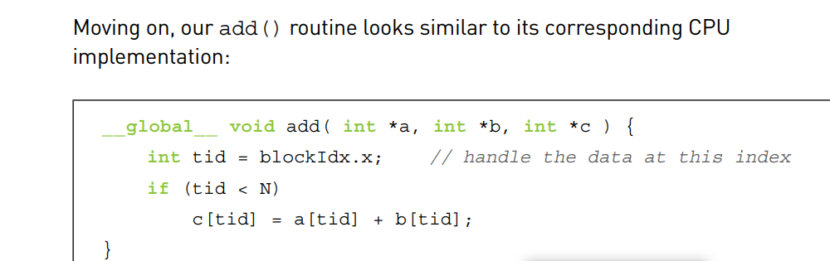

Slide 13
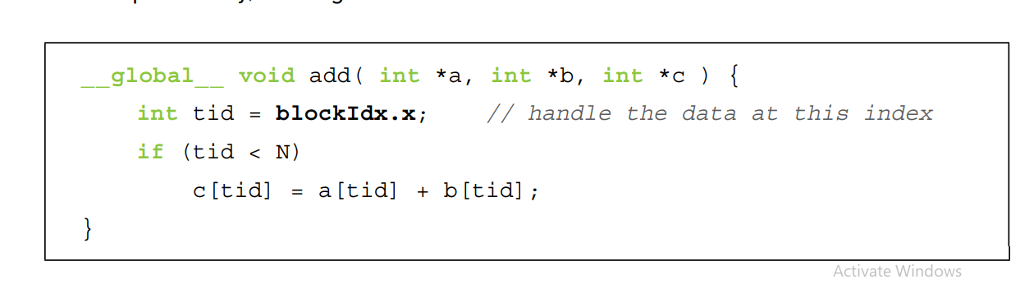

Slide 14
N as the number of parallel blocks.
Collection of parallel blocks a grid.
This specifies to the runtime system that we want a one-dimensional grid of N blocks (scalar values are interpreted as one-dimensional).
These threads will have varying values for blockIdx.x, the first taking value 0 and the last taking value N-1.
Ex: imagine four blocks, all running through the same copy of the device code but having different values for the variable blockIdx.x.
See the figures: Actual code being executed in each of the four parallel blocks looks like after the runtime substitutes the appropriate block index for blockIdx.x

Slide 15
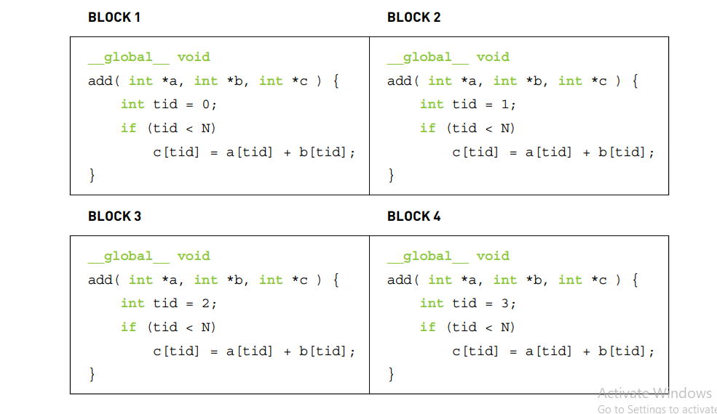

Slide 16
HANDLE_ ERROR() macros that we’ve sprinkled so liberally throughout the code will detect and alert you to the situation.

